Slide 1
Client-Side IPv6 Measurement at Scale
Geoff Huston
APNIC Labs

Slide 2
How to measure millions of end devices for their IPv6 capability?

Slide 3

How to measure millions of end devices for their IPv6 capability?
Be

Slide 4
How to measure millions of end devices for their IPv6 capability?
OR
Have your measurement code run on millions of end devices

Slide 5
APNIC’s Approach
we wanted to measure IPv6 deployment as seen by end users
We wanted to say something about ALL users
So we were looking at a way to sample end users in a random but statistically significant fashion
We stumbled across the advertising networks...

Slide 6


Slide 7
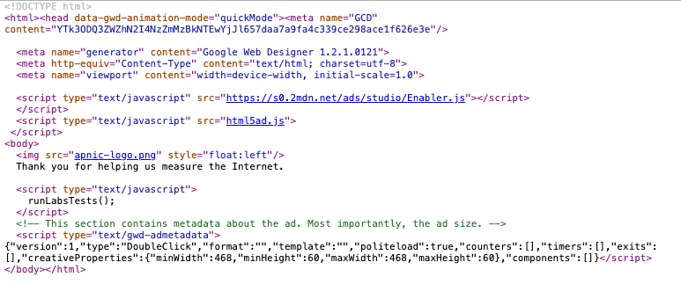

Slide 8


The Ad Measurement Technique
Ad Server
Authoritative Name Server
End user
Web Server

Slide 9
The Ad Measurement Technique
1. Ad Impression
Ad Server
Authoritative Name Server
End user
Web Server

Slide 10
The Ad Measurement Technique
Ad Server
2. DNS resolution
DNS Resolvers
Authoritative Name Server
End user
Web Server

Slide 11
The Ad Measurement Technique
Ad Server
Authoritative Name Server
End user
Web Server
3. Web Fetch

Slide 12
The Ad Measurement Technique
Ad Server
Authoritative Name Server
End user
Web Server
4. Result Web Fetch

Slide 13
What can be scripted
Not much:
  http.FetchImg()
    i.e. attempt to retrieve a URL
But that’s enough!
  It’s EXACTLY what users do!
  A URL consists of a DNS question and an HTML question
  What if we point both the DNS and the HTML to servers we run?
  As long as each Ad execution uses unique names we can push the user query back to our servers

Slide 14
Tests
Think of a URL name as a microcoded instruction set directed to programmable DNS and HTTP servers …
http://06s-u69c5b052-c13-a0461-s1579128735-icb0a3c4c-0.ap.dotnxdomain.net/v61x1.png
Valid DNS
IPv6 access only
Valid DNSSEC signature available
User is located in Country 13 (Australia)
User is in AS1221 (Telstra)
Time is 16 January 2020 9:52am
User’s IPv4 address is 203.10.60.76

Slide 15
Tests
We listen on /64s – so we can use nonce IPv6 addresses
Currently we are looking at encoding IPv4 and time in the IIF to detect replay activities

Slide 16
Ad Placement
At low CPM, the advertising network needs to present unique, new eyeballs to harvest impressions and take your money.
  Therefore, a ‘good’ advertising network provides fresh crop of unique clients per day

Slide 17
Unique IPS?
Collect list of unique IP addresses seen
  Per day
  Since inception
Plot to see behaviours of system
  Do we see ‘same eyeballs’ all the time?

Slide 18
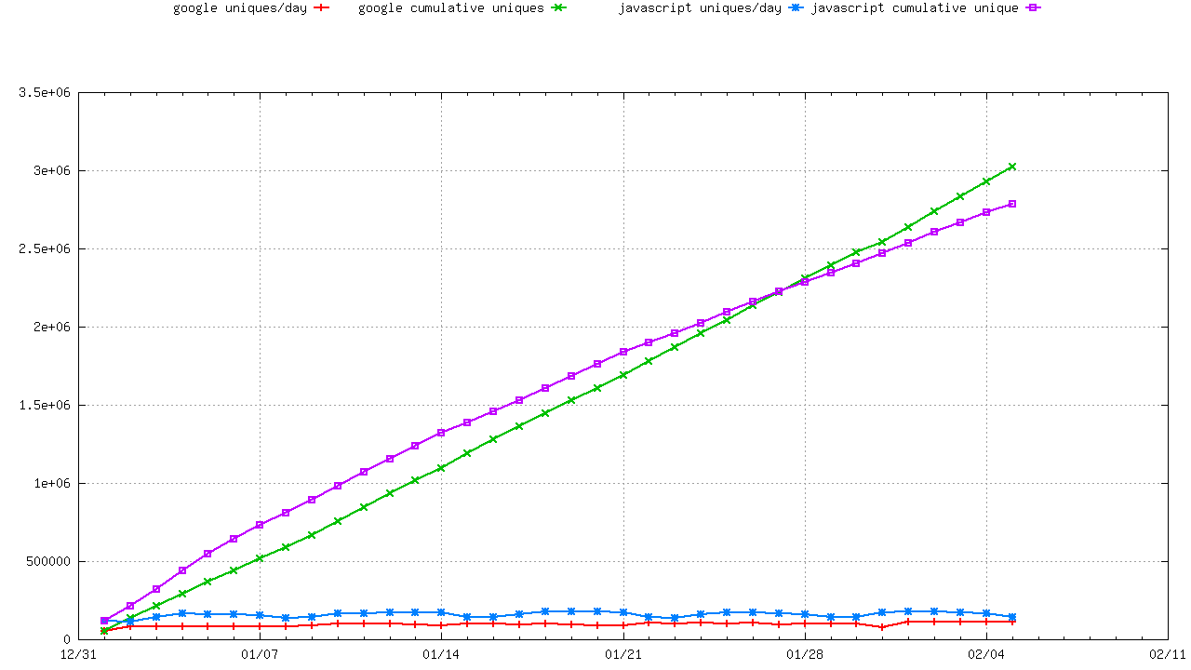
Lots of Unique IP’S
Unique IPs via Ads
Unique IPs via Web Sites

Slide 19
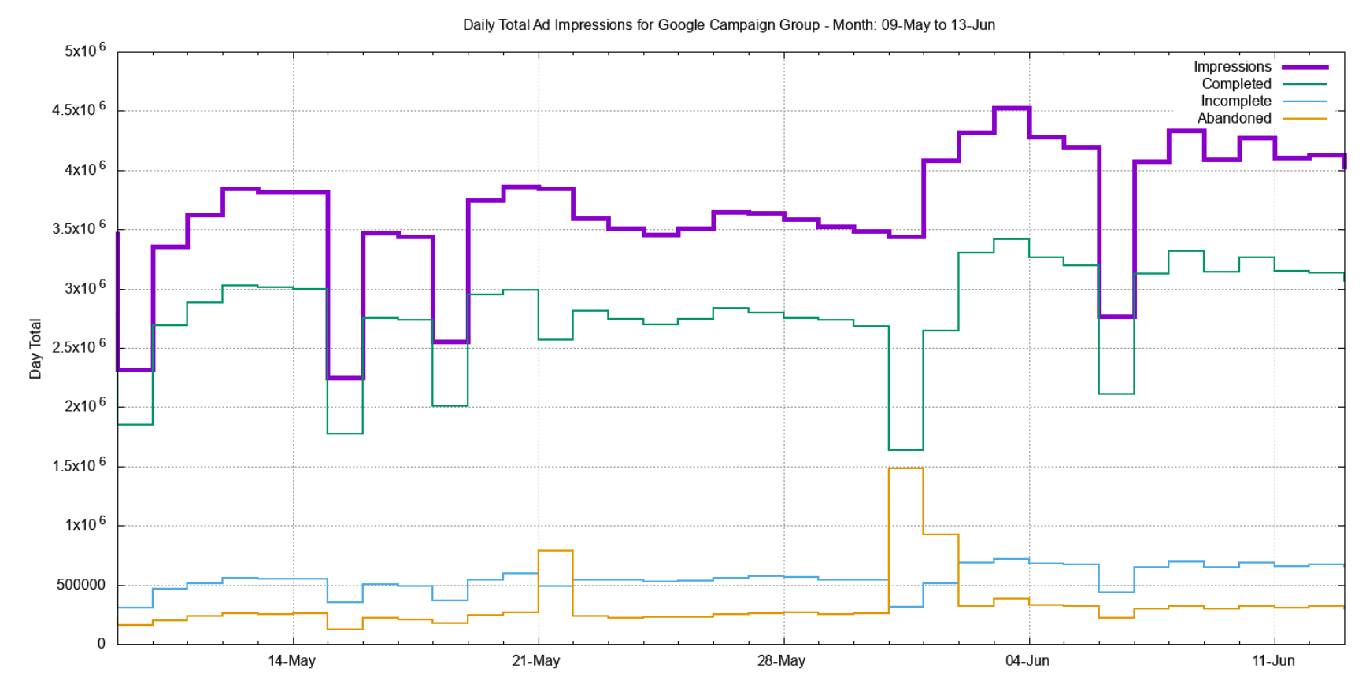
Ad Presentation Volumes

Slide 20
Ad Presentations: Countries

Slide 21
Bias Compensation
The ad presentation is NOT uniform across the Internet’s user population
  The ad machinery ‘over-presents’ in some countries:

Slide 22
Bias Compensation
The ad presentation is NOT uniform across the Internet’s user population
  The ad machinery ‘under-presents’ in some countries:

Slide 23
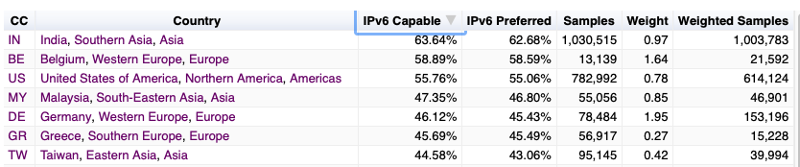
Bias Compensation
Use ITU data on Internet users per country as the reference set, and weight the ad results to compensate for ad placement bias

Slide 24
Dealing with the data
Unified web logs, dns query logs, packet capture
Map individual DNS and HTML transactions using a common experiment identifier
For example:
  DNSSEC validation implies:
    DNS queries include EDNS(0) DNSSEC OK flag set
    See DNS queries for DNSSEC signature records (DNSKEY / DS)
    User fetches URL corresponding to a validly signed DNS name
    User does not fetch URL corresponding to a in validly signed DNS name

Slide 25
What are we measuring?
IPv6 Adoption
IPv6 Dual Stack Preference
IPv6 Performance
IPv6 FragmentationExtension header fragility

Slide 26

What are we seeing?

Slide 27
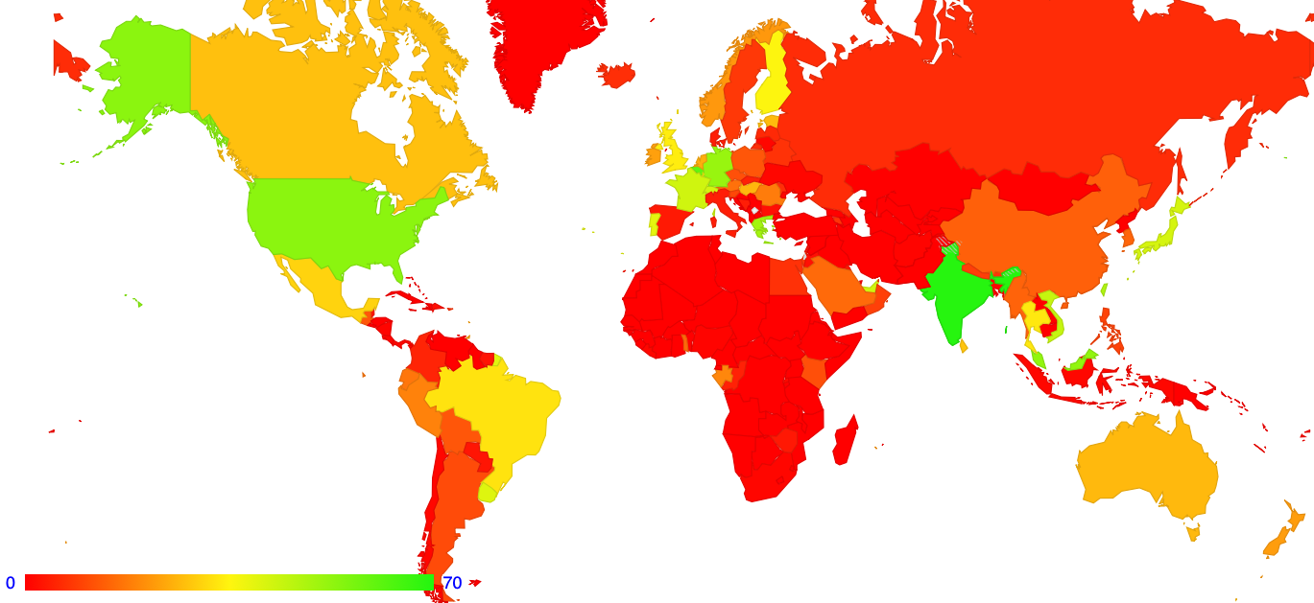
IPv6 Adoption by Country

Slide 28
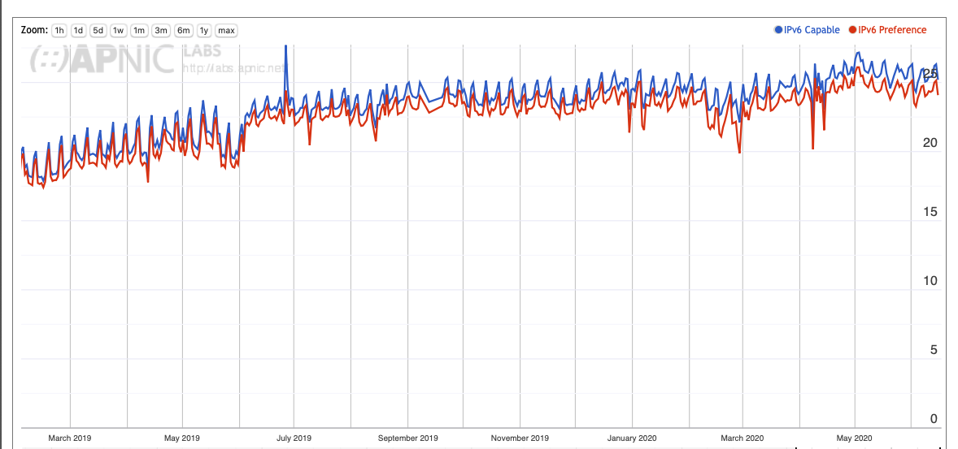
IPv6 Adoption and Preference

Slide 29
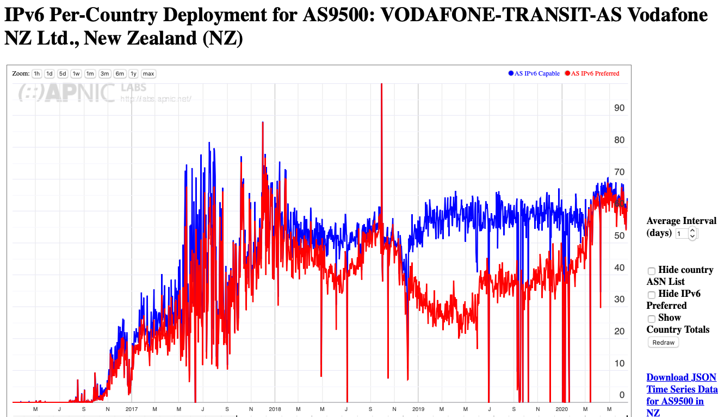
IPv6 Preference

Slide 30
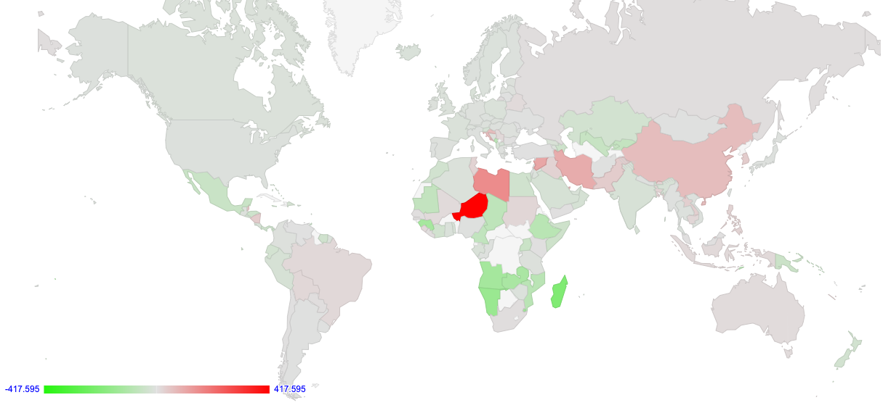

IPv6 Performance

Slide 31
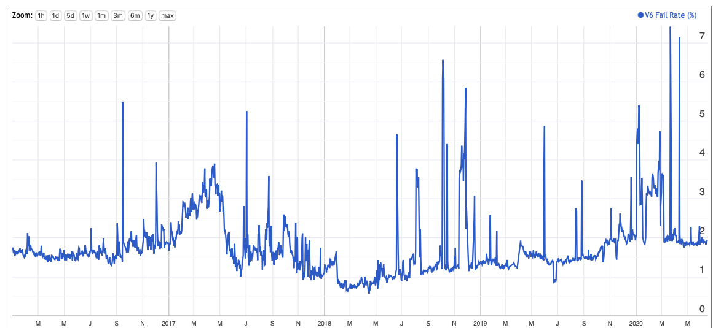
IPv6 Reliability

Slide 32
But…
It’s not a general purpose compute platform, so it can’t do many things
  Ping, traceroute, etc
  Send data to any destination
  Pull data from any destination
  Use different protocols
This is a “many-to-one” styled setup where the server instrumentation provides insight on the inferred behaviour of the edges

Slide 33
Measurement Ethics
There is no user consent
And cookies (even “don’t measurement me!” cookies) are progressively being frowned upon by the ad placement folk
Which means we:
Don’t generate large data volumes
Don’t use ‘compromising’ URL names
Don’t publish PII
Don’t share any raw data from our DNS and HTTP servers

Slide 34
In Summary…
Measuring what happens at the user level by measuring some artifact or behaviour in the infrastructure and inferring some form of user behaviour is always going to be a guess of some form
If you really want to measure user behaviour then its useful to trigger the user to behave in the way you want to study or measure
The technique of embedding simple test code behind ads is one way of achieving this objective
  for certain kinds of behaviours relating to the DNS and to URL fetching

